Slide 1
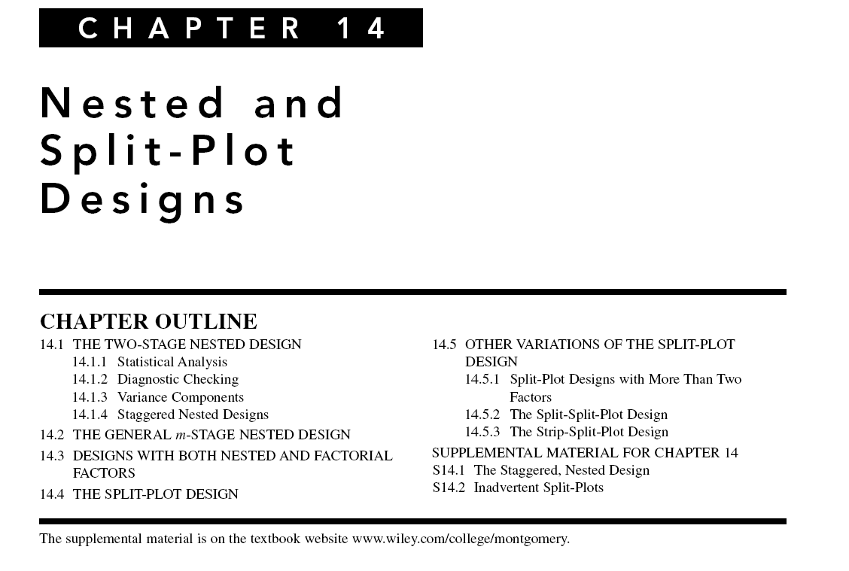

Slide 2
Design of Engineering Experiments – Nested and Split-Plot Designs
Text reference, Chapter 14
These are multifactor experiments that have some important industrial applications
Nested and split-plot designs frequently involve one or more random factors, so the methodology of Chapter 13 (expected mean squares, variance components) is important
There are many variations of these designs – we consider only some basic situations

Slide 3
Two-Stage Nested Design
Section 14.1
In a nested design, the levels of one factor (B) is similar to but not identical to each other at different levels of another factor (A)
Consider a company that purchases material from three suppliers
  The material comes in batches
  Is the purity of the material uniform?
Experimental design
  Select four batches at random from each supplier
  Make three purity determinations from each batch

Slide 4
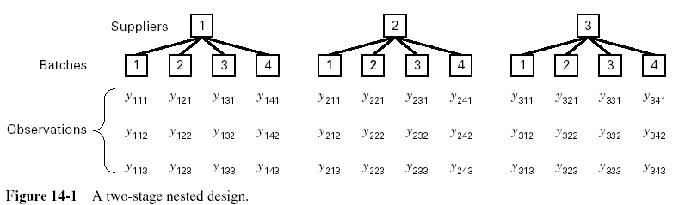
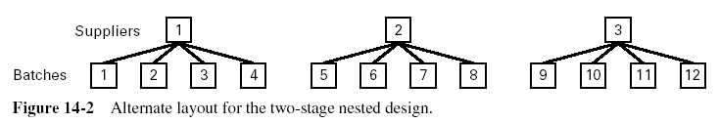
Two-Stage Nested Design

Slide 5
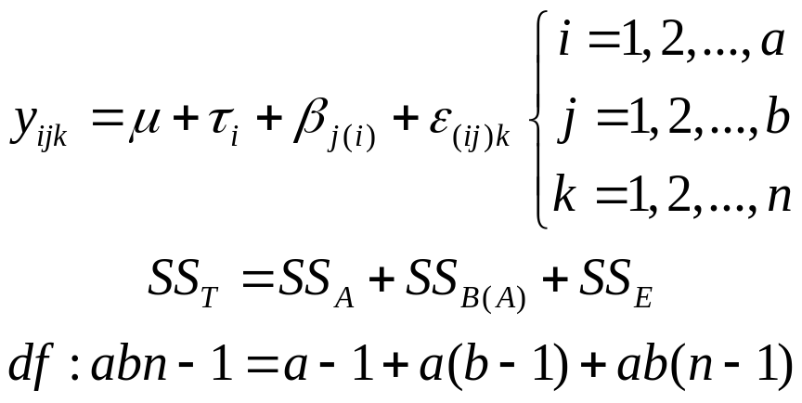
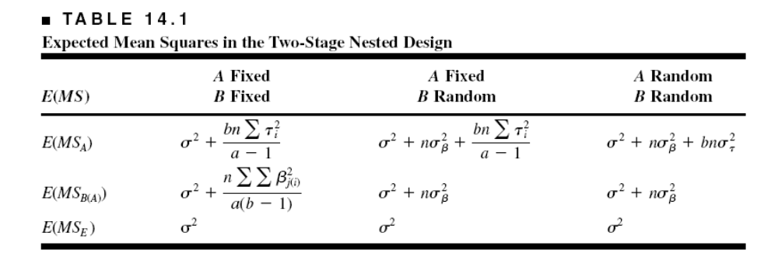
Two-Stage Nested Design
Statistical Model and ANOVA

Slide 6
Two-Stage Nested Design
Example 14.1
Three suppliers, four batches (selected randomly) from each supplier, three samples of material taken (at random) from each batch
Experiment and data, Table 14.3
Data is coded
Minitab balanced ANOVA will analyze nested designs
Mixed model, assume restricted form

Slide 7
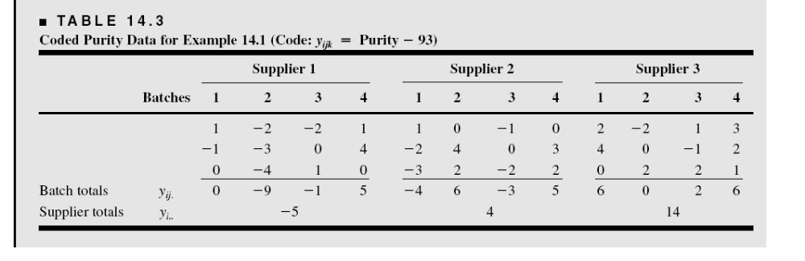

Slide 8
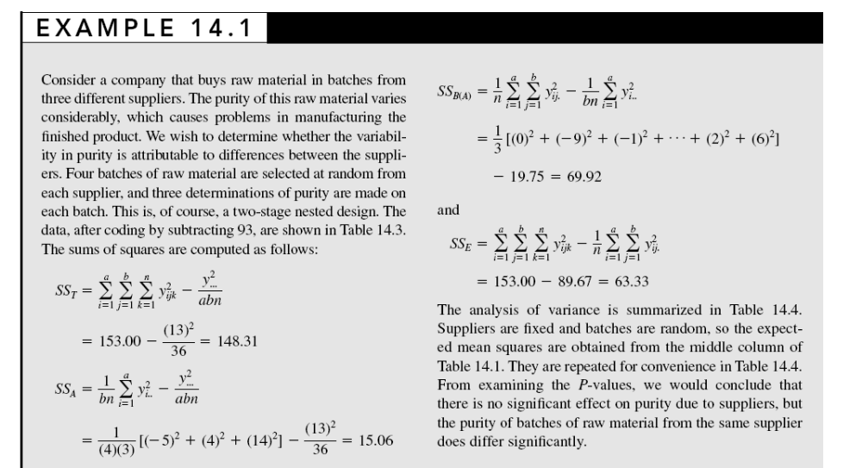

Slide 9
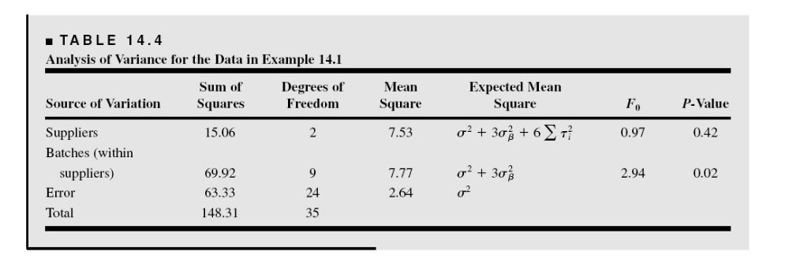

Slide 10
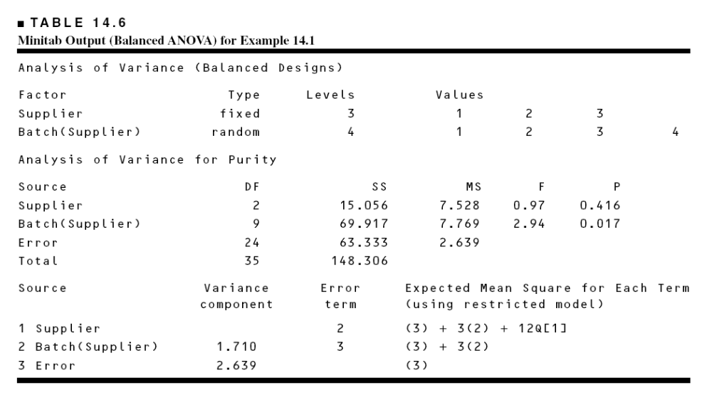
Minitab Analysis

Slide 11
Practical Interpretation – Example 14.1
There is no difference in purity among suppliers, but significant difference in purity among batches (within suppliers)
What are the practical implications of this conclusion?
Examine residual plots – plot of residuals versus supplier is very important (why?)
What if we had incorrectly analyzed this experiment as a factorial? (see Table 14.5)
Estimation of variance components

Slide 12
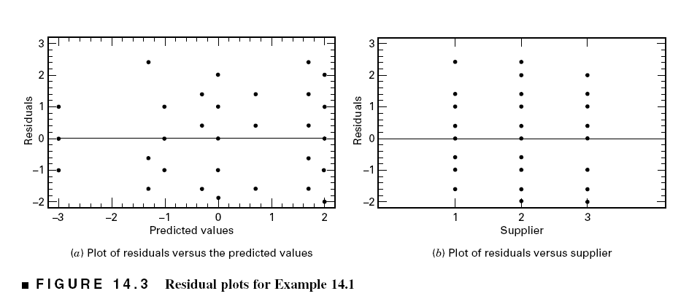

Slide 13
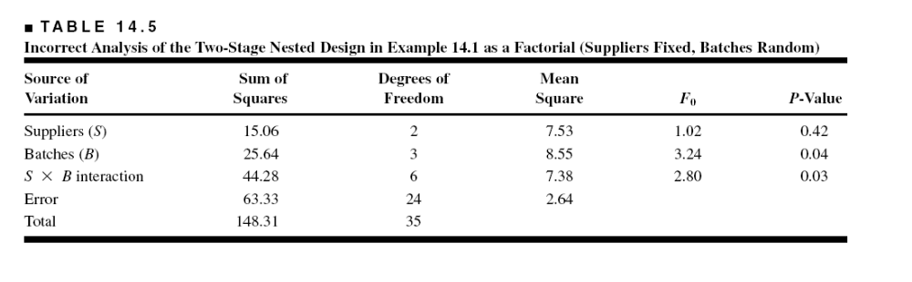

Slide 14
Variations of the Nested Design
Staggered nested designs
  Prevents too many degrees of freedom from building up at lower levels
  Can be analyzed in Minitab (General Linear Model) – see the supplemental text material for an example
Several levels of nesting
  The alloy formulation example
  This experiment has three stages of nesting
Experiments with both nested and “crossed” or factorial factors

Slide 15
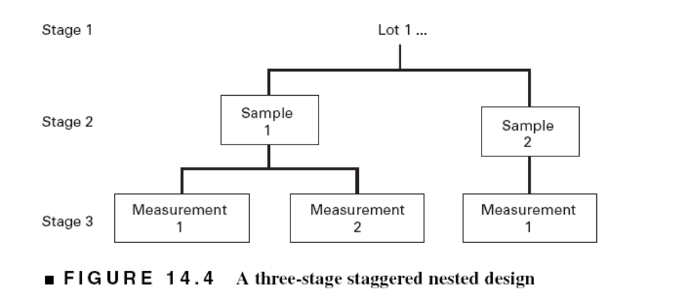

Slide 16
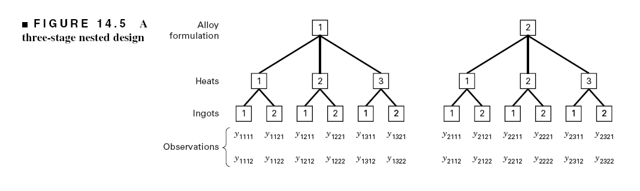

Slide 17
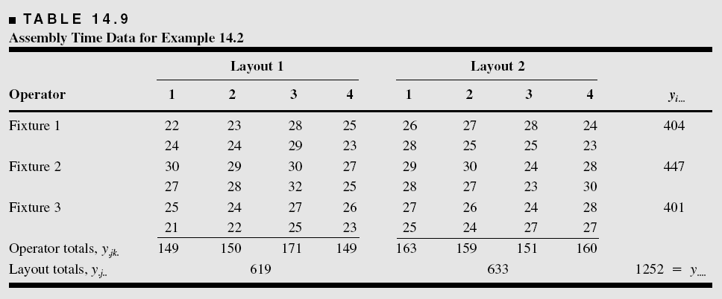
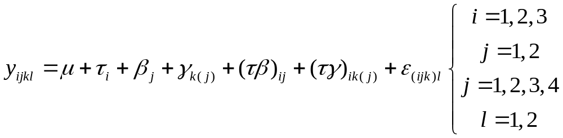
Example 14.2 Nested and Factorial Factors

Slide 18
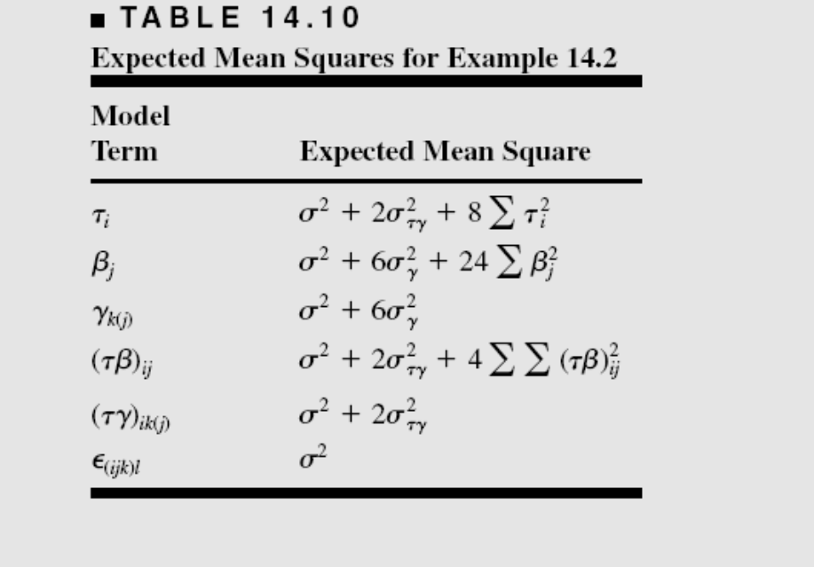
Example 14.2 – Expected Mean Squares
Assume that fixtures and layouts are fixed, operators are random – gives a mixed model (use restricted form)

Slide 19
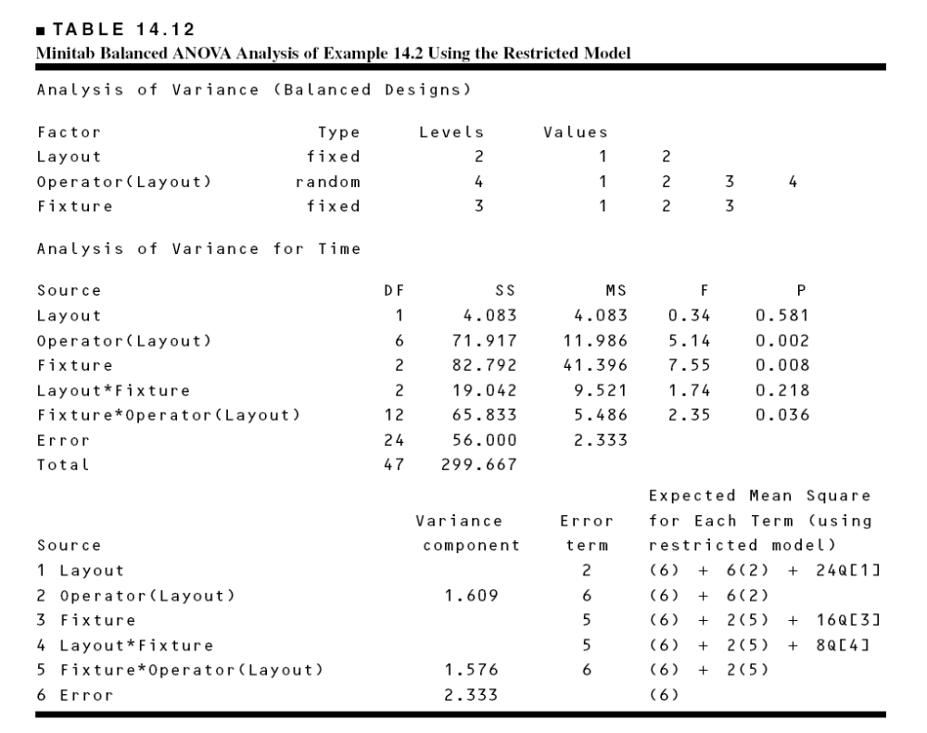
Example 14.2 – Minitab Analysis

Slide 20
The Split-Plot Design
Text reference, Section 14.4 page 557
The split-plot is a multifactor experiment where it is not possible to completely randomize the order of the runs
Example – paper manufacturing
  Three pulp preparation methods
  Four different temperatures
  Each replicate requires 12 runs
  The experimenters want to use three replicates
  How many batches of pulp are required?

Slide 21
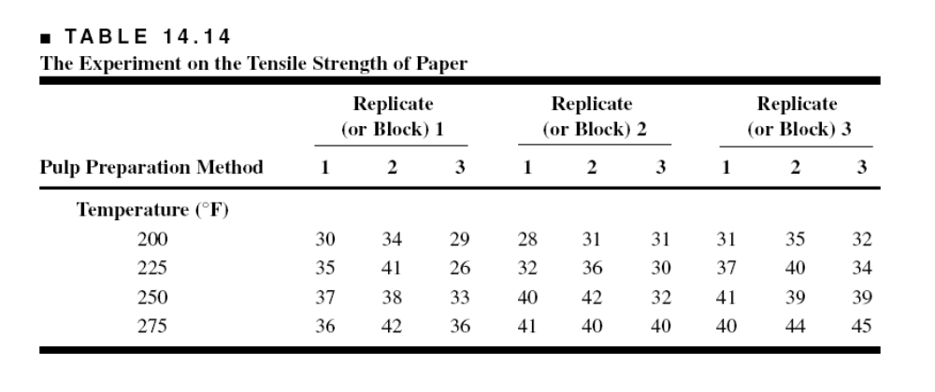

Slide 22
The Split-Plot Design
Pulp preparation methods is a hard-to-change factor
Consider an alternate experimental design:
  In replicate 1, select a pulp preparation method, prepare a batch
  Divide the batch into four sections or samples, and assign one of the temperature levels to each
  Repeat for each pulp preparation method
  Conduct replicates 2 and 3 similarly

Slide 23
The Split-Plot Design
Each replicate (sometimes called blocks) has been divided into three parts, called the whole plots
Pulp preparation methods is the whole plot treatment
Each whole plot has been divided into four subplots or split-plots
Temperature is the subplot treatment
Generally, the hard-to-change factor is assigned to the whole plots
This design requires only 9 batches of pulp (assuming three replicates)

Slide 24
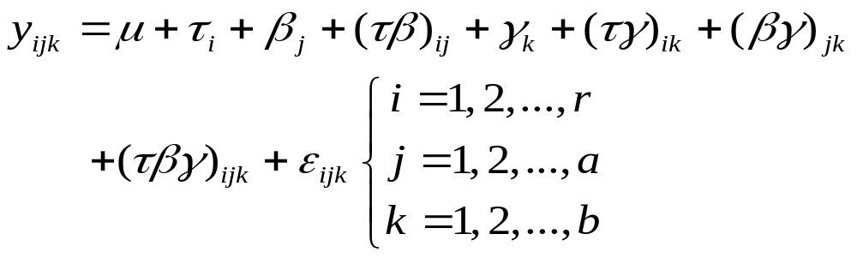
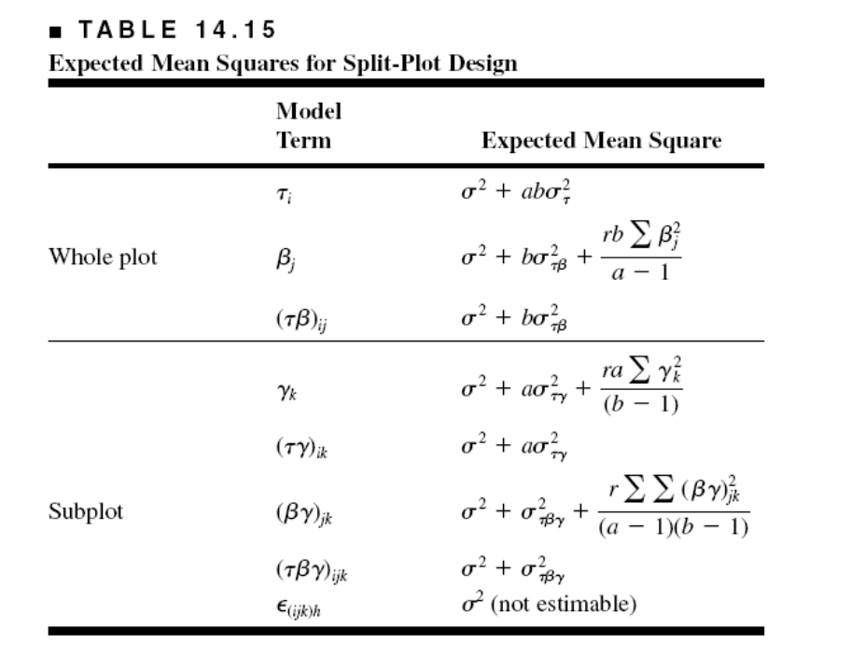
The Split-Plot Design
Model and Statistical Analysis
There are two error structures; the whole-plot error and the subplot error

Slide 25
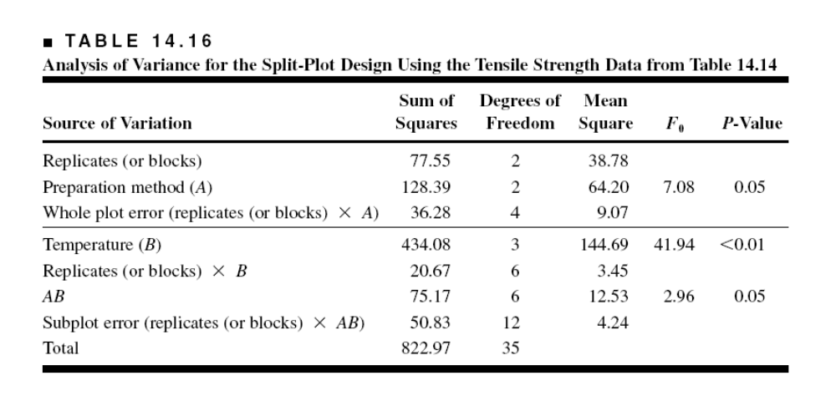
Split-Plot ANOVA
Calculations follow a three-factor ANOVA with one replicate
Note the two different error structures; whole plot and subplot

Slide 26
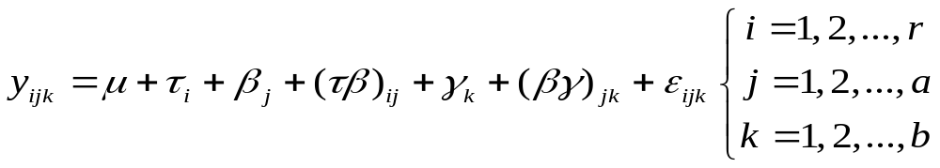
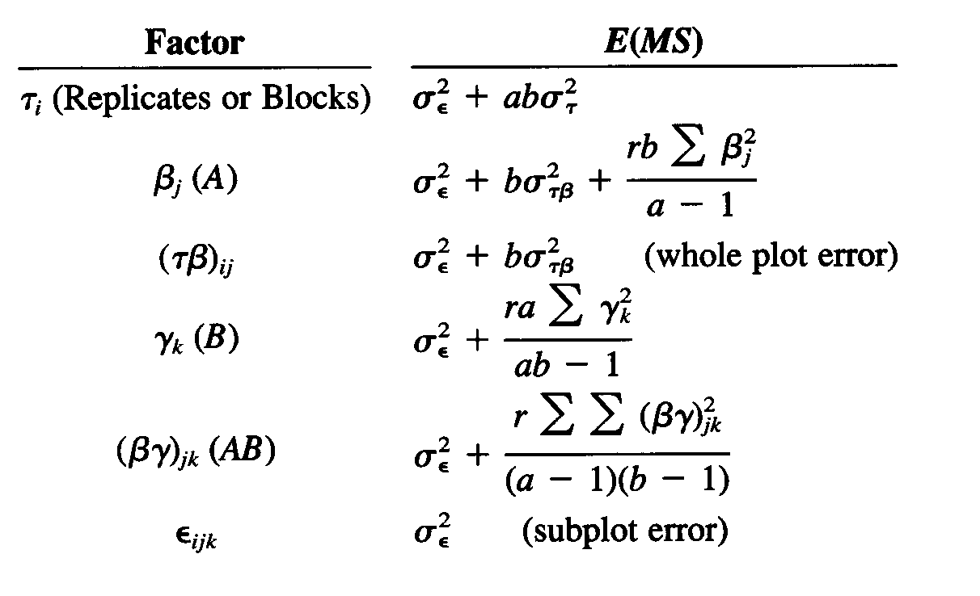
Alternate Model for the Split-Plot

Slide 27
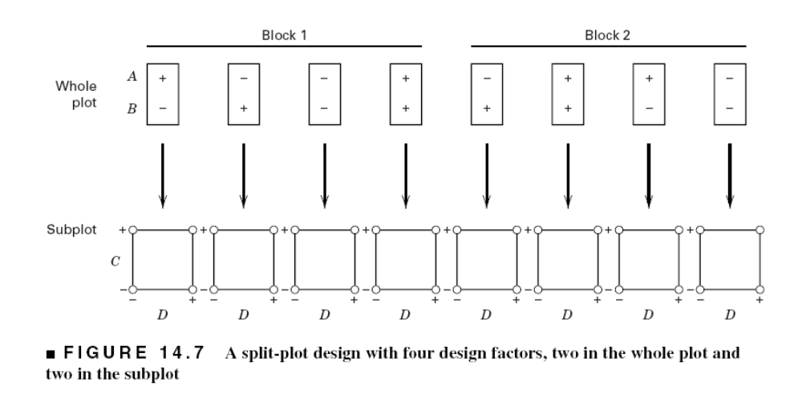
Variations of the basic split-plot design
More than two factors – see page 562
A & B (gas flow & temperature) are hard to change; C & D (time and wafer position) are easy to change.

Slide 28
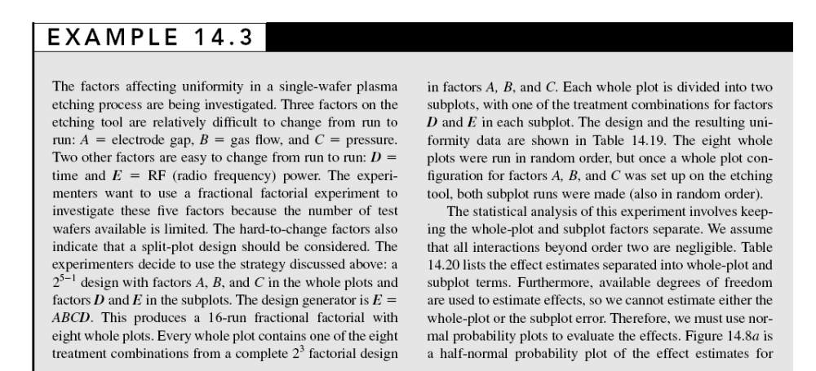
Unreplicated designs and fractional factorial design in a split-plot framework

Slide 29
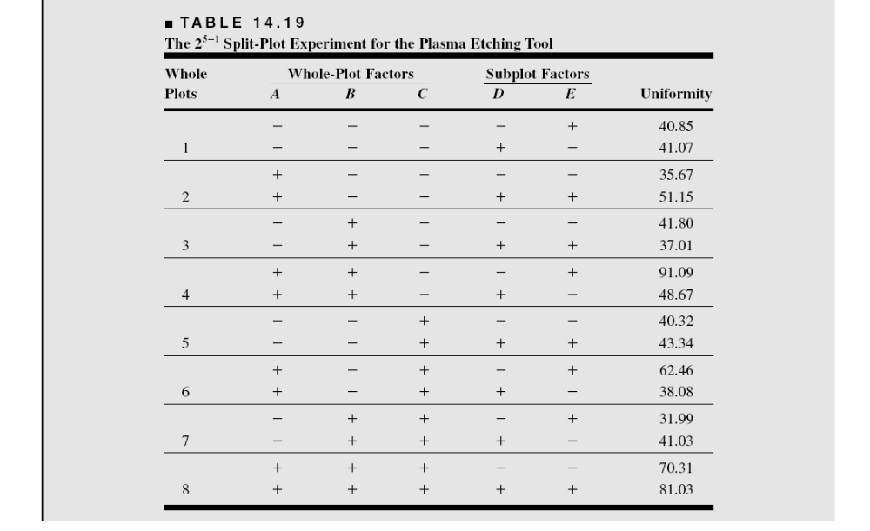

Slide 30
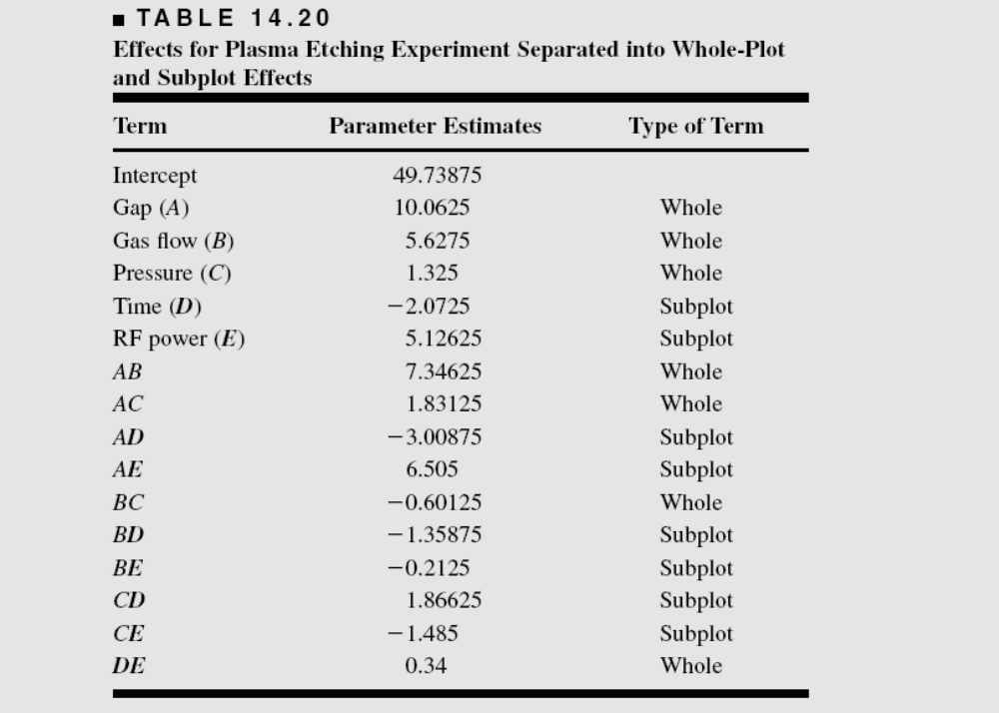

Slide 31
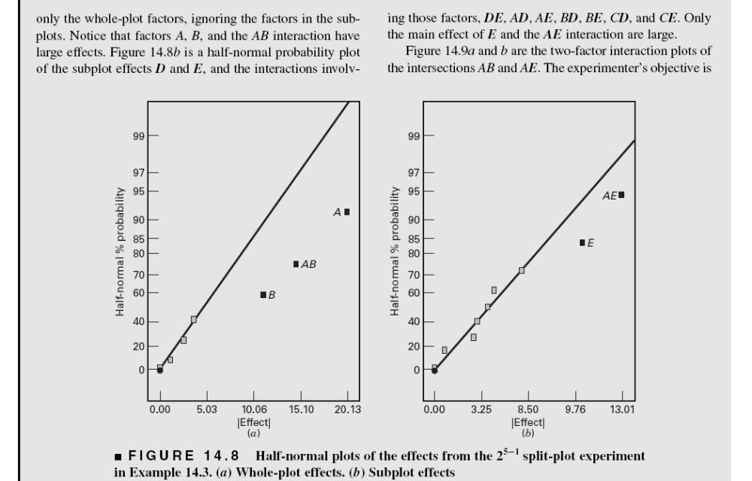

Slide 32
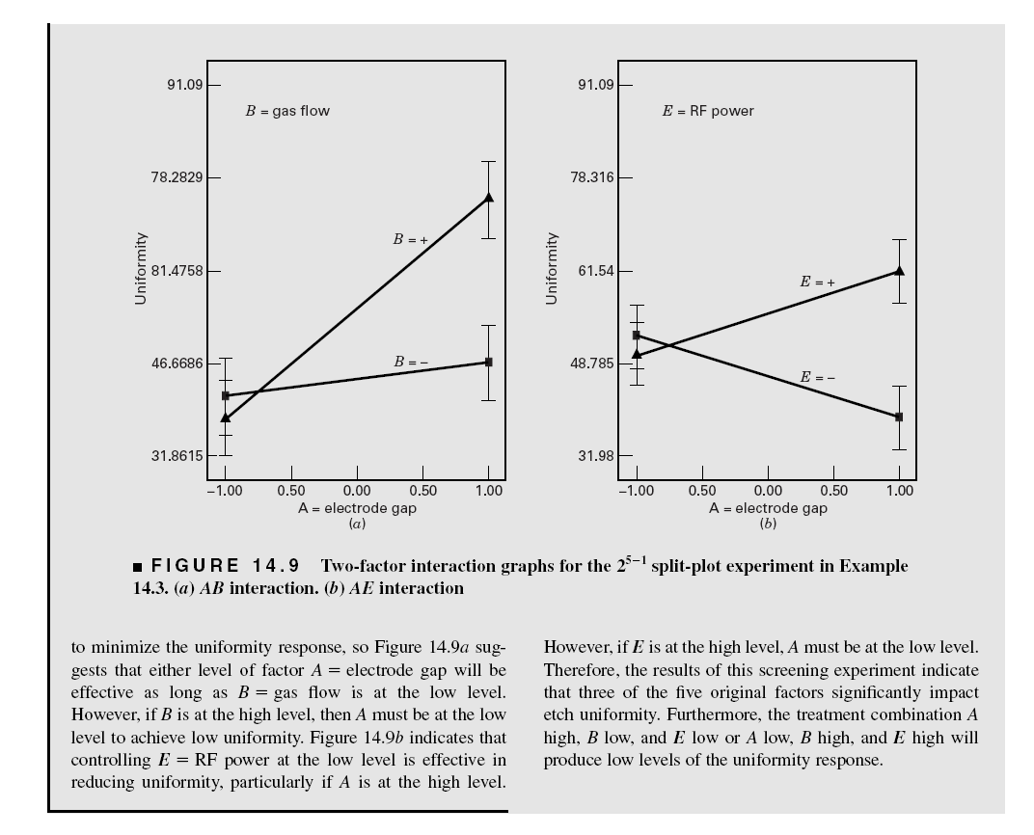

Slide 33
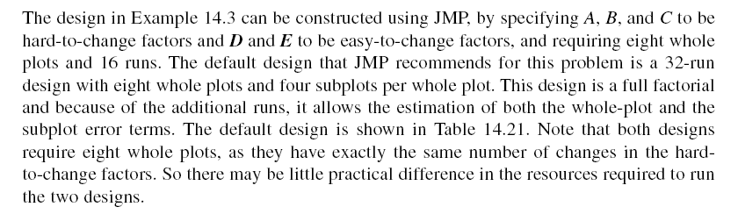

Slide 34
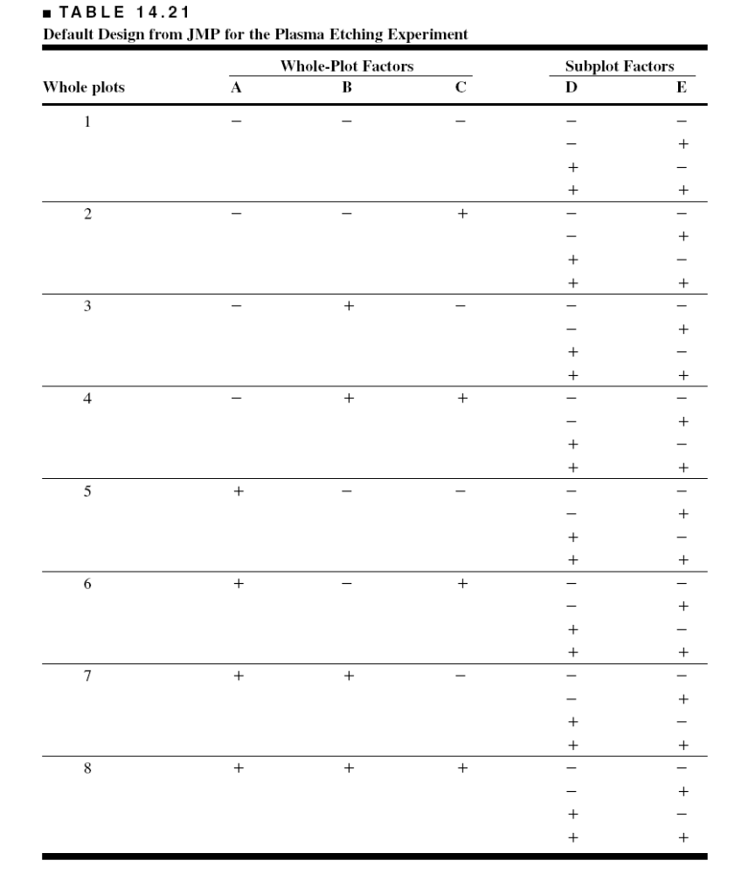

Slide 35
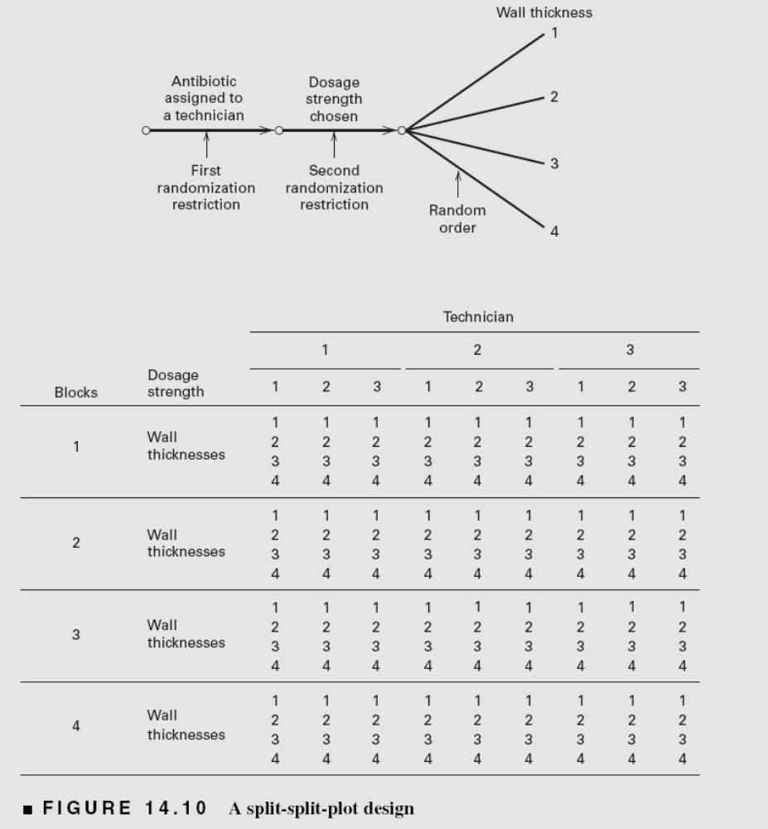
A split-split-plot design
Two randomization restrictions present within each replicate

Slide 36
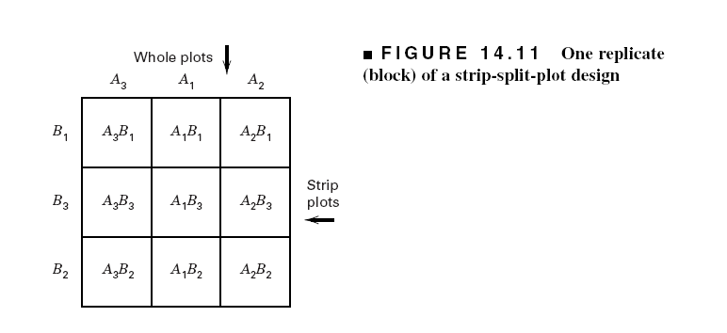
The strip-split-plot design
The “strips” are just another set of whole plots

